Slide 1
SOLAR FORECASTING
GROUP 33
ABHIMANYU SINGH BISHT 2001CB04
KHUSHI SHAH 2001EE91
SYED IBRAHIM AHMED 2001ME77
ANSHUL THAKKAR 2001EE86
SAI NANDAN PANIGRAHY 2001CB46
SYED SHAHEER TANVEER 2001CB58

Slide 2
Introduction
Solar energy is a leading renewable source - offering many environmental advantages over fossil fuels for electricity generation.
Since it depends on sunlight, a non steady natural resource, it is critical for solar grids to have output predictability.
Solar power forecasting can aid in the growth of solar power.
Further, accurate predictions promise the optimality of energy transition from conventional to renewable energy sources.
Notes:
In this case, the solar PhotoVoltaic is in the head of interest by the global investment. Despite the existence of policies and regulation, the innovation and the corporate commitments, the integration of solar PV in the power grids is suffering from both problems of unpredictability of weather parameters and poor infrastructure grids, which minimize the high penetration of solar PV. In this way, the forecasting techniques can help the rise of solar PV and promise the optimality of energy transition management between intermittent and conventional energies by providing the solar power forecasts in various time and spatial horizons. Subsequently, solar forecasting can support the grid operator by providing the future energy generated through the solar PV installations, which can help the planning and scheduling of the effective unit commitments to meet the market demands.

Slide 3
Problem Statement
Due to Solar energy fluctuations with changing weather conditions, electric utility companies are in need of accurate forecasts of energy production in order to have the right balance of renewable and fossil fuels available. Errors in the forecast could lead to large expenses for the utility from excess fuel consumption or emergency purchases of electricity from neighboring utilities.
The goal of this project is to discover which statistical and machine learning techniques provide the best short term predictions of solar energy production.

Slide 4
Data Collection
A.

Slide 5
Data Collection
So far the most time consuming task of the project.
The provided kaggle dataset was unavailable.
Thus, the team went through 20+ research papers and blogs to find a dataset that had necessary features and could be accessed easily.
Some papers were too advanced, many more did not have proper access to data. We worked on few datasets before settling on this one.
Notes:
The demand of energy by miscellaneous areas and the worldwide energy exploitation are really highest than any time before. In addition to the uppermost energy demand, oil and other planet’s resources in fossil are becoming scarce. In this case, the environmentalists, the socialists, and the economists are supporting the climatic agreements and adopting the clean energy as a solution to retort the global energy demand, the cost effectiveness, and the ecological consequences such as the universal challenge caused by global warming and the greenhouse effect.In this case, the solar PV is in the head of interest by the global investment. Despite of the policies and regulation, the innovation, and the corporate commitments, the integration of solar PV in the power grids is suffering from both problems of unpredictability of weather parameters and poor infrastructure grids, which minimize the high penetration of solar PV. In this way, the forecasting techniques can help the rise of solar PV and promise the optimality of energy transition management between intermittent and conventional energies by providing the PV power forecasts in various time and spatial horizons. Subsequently, the PV power forecasting can support the grid operator by providing the future energy generated through the solar PV installations, which can help the planning and scheduling of the effective unit commitments to meet the market demands. In addition, the PV power forecasting is advantageous for the benefit of new power generation such as the microgrids, in which they are smart, small microgenerations, based on numerous microsources including the solar PV.

Slide 6
Data Collection - NREL
Among the datasets we had come across, the most notable was an open source database made for solar forecasting, NREL
The high res dataset could only be accessed through an API. This gave us experience with working with APIs to collect data.
It would have taken us a long time to collect relevant dataset of a desirable size. Thus we had to abandon the project idea.

Slide 7
Data Collection - Open Power Project
Another good option was a database that contained information about electricity consumption and wind, solar energy generation across Europe. This was a part of an open source, power project.
Initially, the dataset seemed to be our endpoint. Unfortunately, an important factor for solar forecasting- The solar Zenith angle, was missing.

Slide 8
Data Collection - Others
30 YEARS OF EUROPEAN SOLAR GENERATION - It only has the hourly solar power generation time series thus wasn’t ideal for any predictions.
Horizontal Photovoltaic Power Output Data - We also came across a Kaggle dataset that had been used for solar photovoltaic prediction. The data consists of 14 months of power output, location, and weather data. While we did begin working with this, we had to soon forfeit our work as after the data after processing was too little to make any accurate prediction.

Slide 9
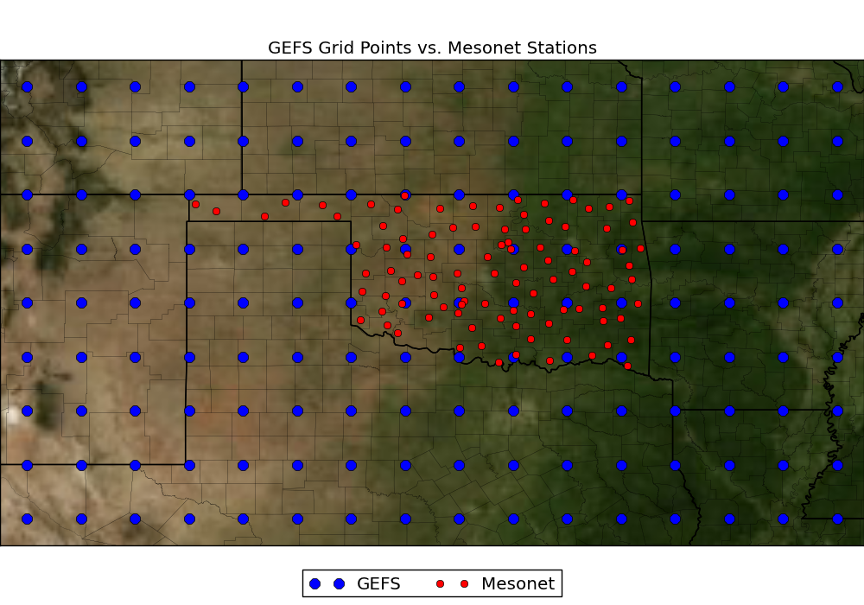
Data Collection - Final Dataset
Our search ended when we came across a solar prediction contest dataset on kaggle.
The dataset consists of incoming solar radiation and related data across 98 Oklahoma Mesonet sites.
Data include all 11 ensemble members and the forecast timesteps 12, 15, 18, 21, and 24.
The Training data is from 1994-2007, while public testing data is from 2008-2012.

Slide 10
Understanding The Dataset
The training data are separated into 15 .nc files corresponding to all the variables.
gefs_train.zip and gefs_test.zip contain all of the GEFS training data.
Each netCDF file contains the latitude-longitude grid and time step values as well as metadata listing the full names of each variable and the associated units.

Slide 11
Understanding The Dataset
The first dimension is the date of the model run and will correspond directly with a row in the train.csv file.
The second dimension is the ensemble member that the forecast comes from.
The third dimension is the forecast hour, which runs from 12 to 24 hours in 3 hour increments.
The fourth and fifth dimensions are the latitude and longitude uniform spatial grid.

Slide 12
TABLE
Variable | Description | Units
tmin_2m | Mininmum Temperature over the past 3 hours at 2 m above the ground | K
tmp_2m | Current temperature at 2 m above the ground | K
tmp_sfc | Temperature of the surface | K
ulwrf_sfc | Upward long-wave radiation at the surface | W m-2
ulwrf_tatm | Upward long-wave radiation at the top of the atmosphere | W m-2
uswrf_sfc | Upward short-wave radiation at the surface | W m-2
tmax_2m | Maximum Temperature over the past 3 hours at 2 m above the ground | K
tcolc_eatm | Total column-integrated condensate over the entire atmos. | kg m-2
Variable | Description | Units
apcp_sfc | 3-Hour accumulated precipitation at the surface | kg m-2
dlwrf_sfc | Downward long-wave radiative flux average at the surface | W m-2
dswrf_sfc | Downward short-wave radiative flux average at the surface | W m-2
pres_msl | Air pressure at mean sea level | Pa
pwat_eatm | Precipitable Water over the entire depth of the atmosphere | kg m-2
spfh_2m | Specific Humidity at 2 m above ground | kg kg-1
tcdc_eatm | Total cloud cover over the entire depth of the atmosphere | %

Slide 13
Data Preprocessing and Cleaning
B.

Slide 14
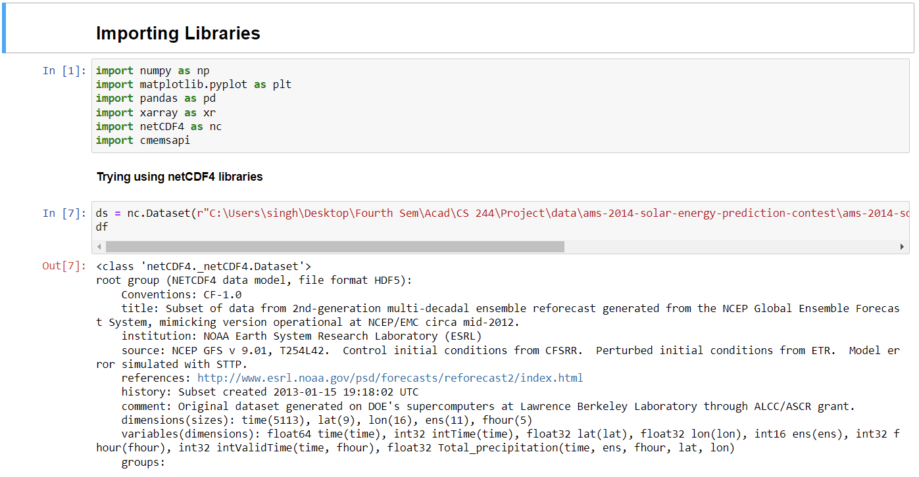
Preprocessing -
Uploaded the data on our google drive and imported to our google collab notebook.
The very first problem we faced was that our data was in .nc format which is not supported by standard libraries like Pandas, Numpy, Scipy… We tried exploring the netCDF4 library which is used to handle .nc files but the process was too time consuming.

Slide 15
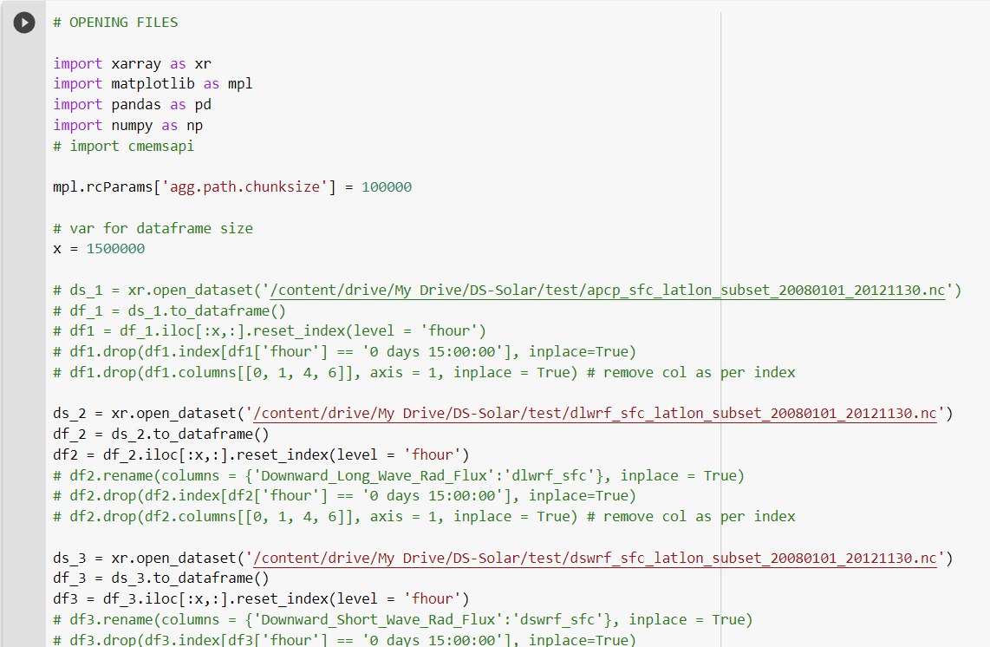
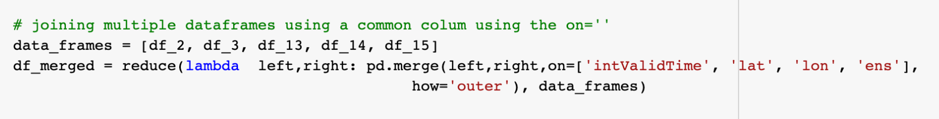
Preprocessing -
Then by using xarray library (another tool used to handle multi-dimensional arrays) we converted the multidimensional arrays to Pandas (used to handle large data) dataframe.
This was followed by an iterative process of creating multiple data-series, converting them to data frames, merging them together and resetting the indexes everytime we do so.

Slide 16
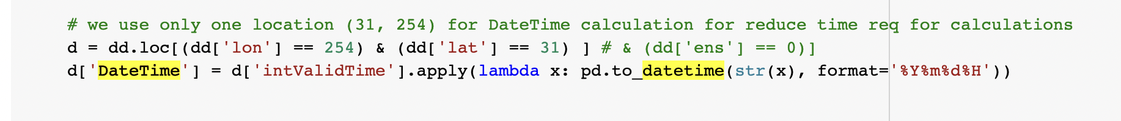
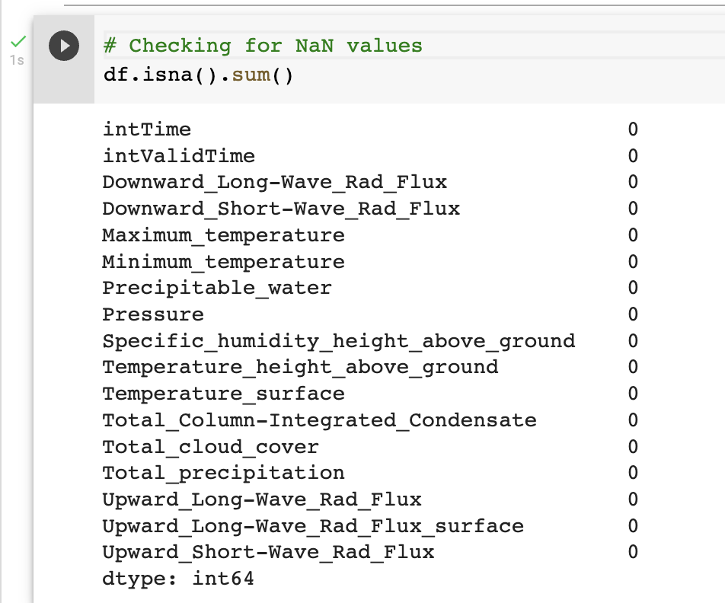
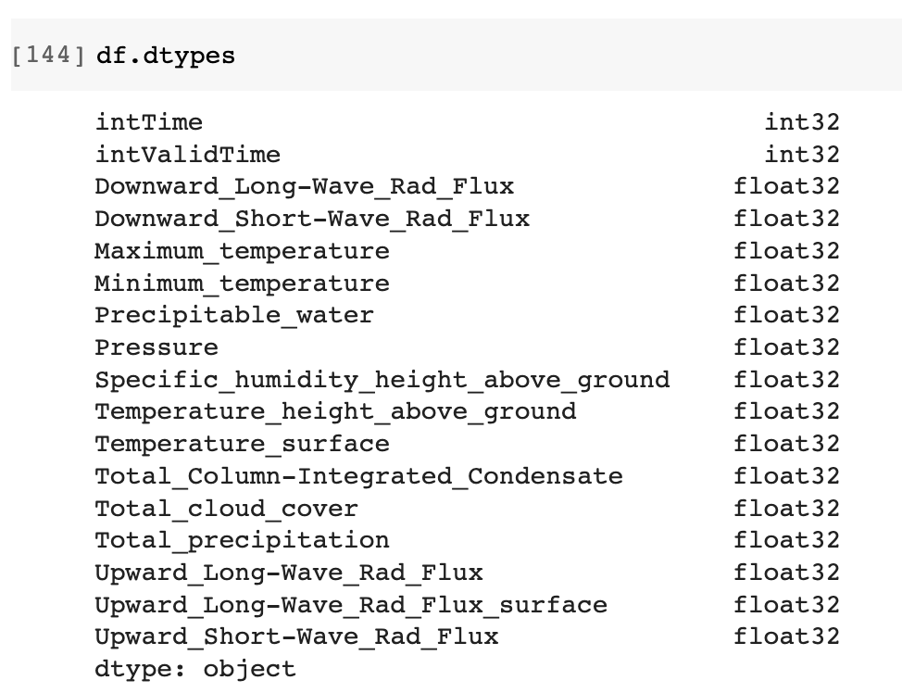
Preprocessing -
We created a new feature - Net Radiation = Downward_short + Downward_long flux.
We created a new feature - DateTime .
We also checked for any missing data but did not come across any.
Next, we checked the datatypes of the values of our features. They were uniform by default so didn’t require any changes there.

Slide 17
Data Visualization
C.

Slide 18
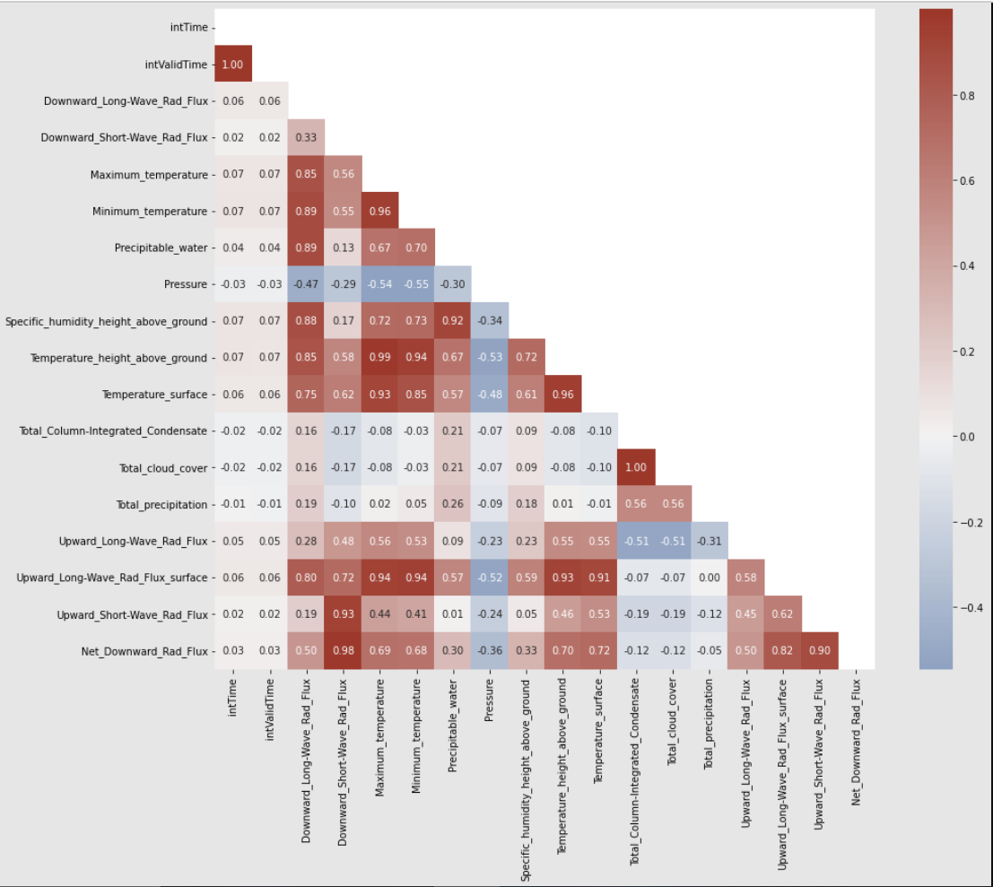
4 Plots have been used to Visualize Data:
This Heat Map portrays the correlation between the variables (columns of the dataframe) using the pearson standard correlation coefficient*.
From here, we observe a strong correlation between Net_downward_Radiation_flux and dswrf_sfc, ulwrf_sfc, uswrf_sfc as well as tmp_sfc.
*Pearson's Correlation Coefficient is a linear correlation coefficient that returns a value of between -1 and +1.

Slide 19
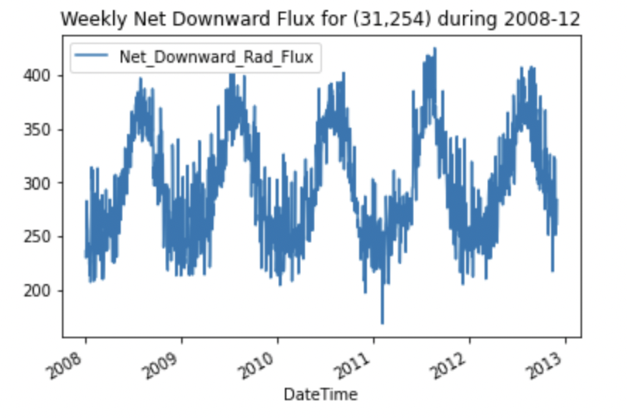
Line Plot:
A line plot has been shown to demonstrate the variation of weekly average of net downward flux specific to one location (lat=31° , long=254°) during the years, 2008-2012.
Clearly, in the summer months, the net radiation peaks as expected.

Slide 20
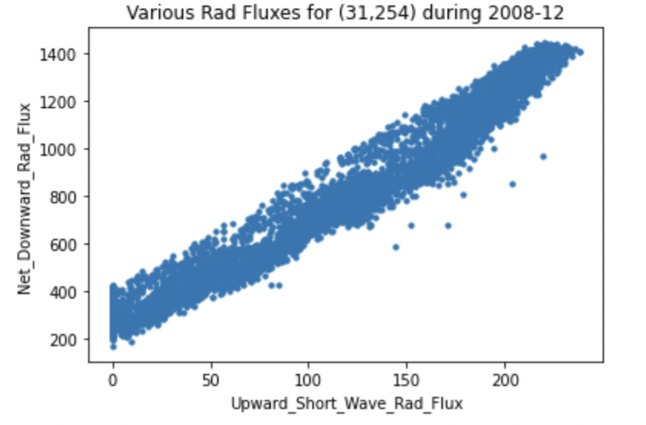
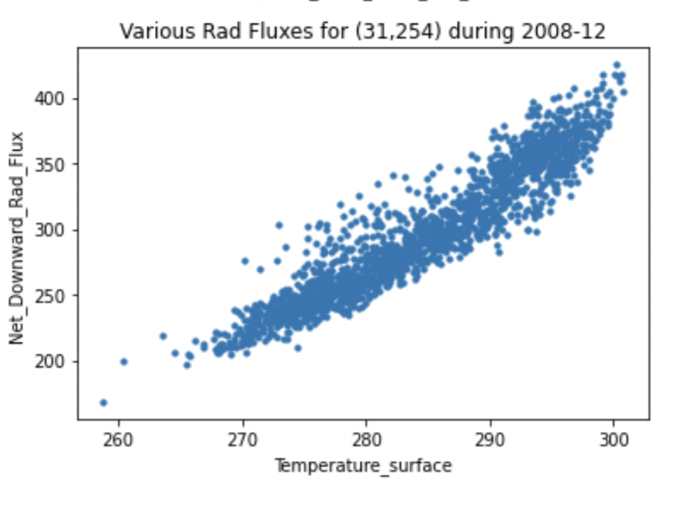
Scatter plots:
Here, using these plots, the correlations defined by the heatmap have been confirmed.
Notes:
For left (from heatmap we had correlation = 0.9)
For right((from heatmap we had correlation =0.72)
Looking at the positive slopes confirms the positive correlation that can be seen from the heatmap.

Slide 21
D.
Data Statistics

Slide 22
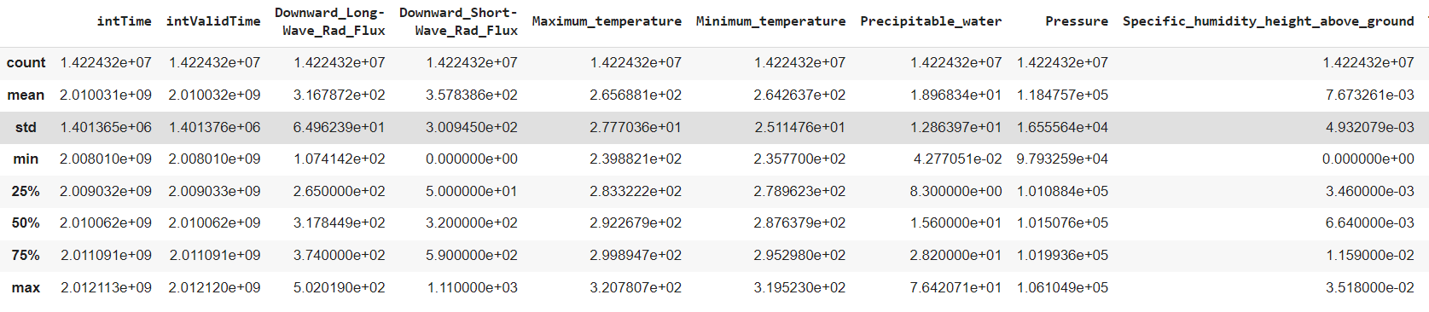
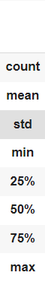
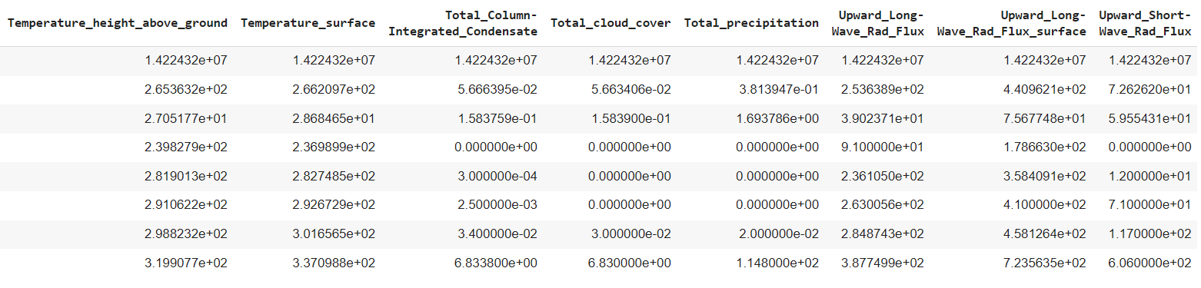
A Brief Statistical Summary:
Notes:
Pandas offers an awesome function, called describe, which can be used to obtain a brief statistical summary of the data. We can easily see frequently used statistics, like mean, standard deviation, minimum value, maximum value, etc for all the data frame columns in a single table.

Slide 23
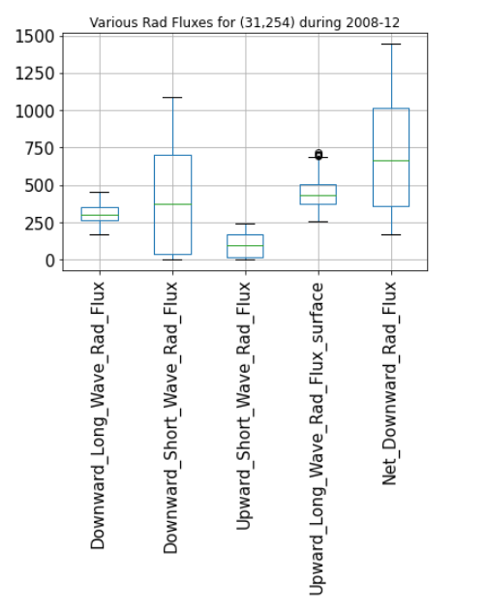
Box Plot-
Box plots help visualize the distribution of quantitative values in a field. They are also valuable for comparisons across different categorical variables or identifying outliers, if either of those exist in a dataset.
In this case, we have used a boxplot of the given features in order to observe their minimum value, median and the maximum value at a glance. For our data, the line graph of the entire dataset was unable to give such detailed information.
Notes:
We have showed the data using box plots for a better visualization.
And here in this case we have used boxplots of the given features of the dataset we used in order to observe their median, min value, max value and 25th and 75th percentiles.

Slide 24
Hypothesis Testing
E.

Slide 25
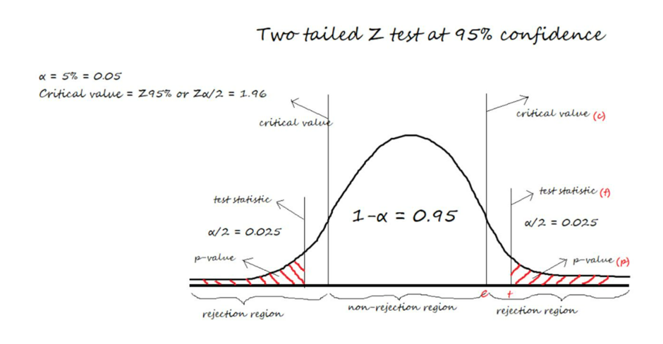
Null Hypothesis
We propose that if we take a sample from a random location (31, 259), the mean of that particular sample doesn’t deviate much from the mean of the total population.
In this respect, we take the significance value cut-off (alpha) to be 0.05 (or 5%).
Notes:
Box plots help visualize the distribution of quantitative values in a field. They are also valuable for comparisons across different categorical variables or identifying outliers, if either of those exist in a dataset. In this case, we have used a boxplot of the given features in order to observe their minimum value,median and the maximum value at a glance. For our data, the line graph of the entire dataset was unable to give such detailed information.

Slide 26
Alternate Hypothesis
The alternate hypothesis would be that the mean of a random sample would actually deviate from the mean of the total population.
If we run z-test on our hypothesis and find out the p-value to be less than the significance value cut-off, then we can simply reject the null hypothesis.
P < 0.05
THEN
REJECT NULL HYPOTHESIS
Notes:
Box plots help visualize the distribution of quantitative values in a field. They are also valuable for comparisons across different categorical variables or identifying outliers, if either of those exist in a dataset. In this case, we have used a boxplot of the given features in order to observe their minimum value,median and the maximum value at a glance. For our data, the line graph of the entire dataset was unable to give such detailed information.

Slide 27
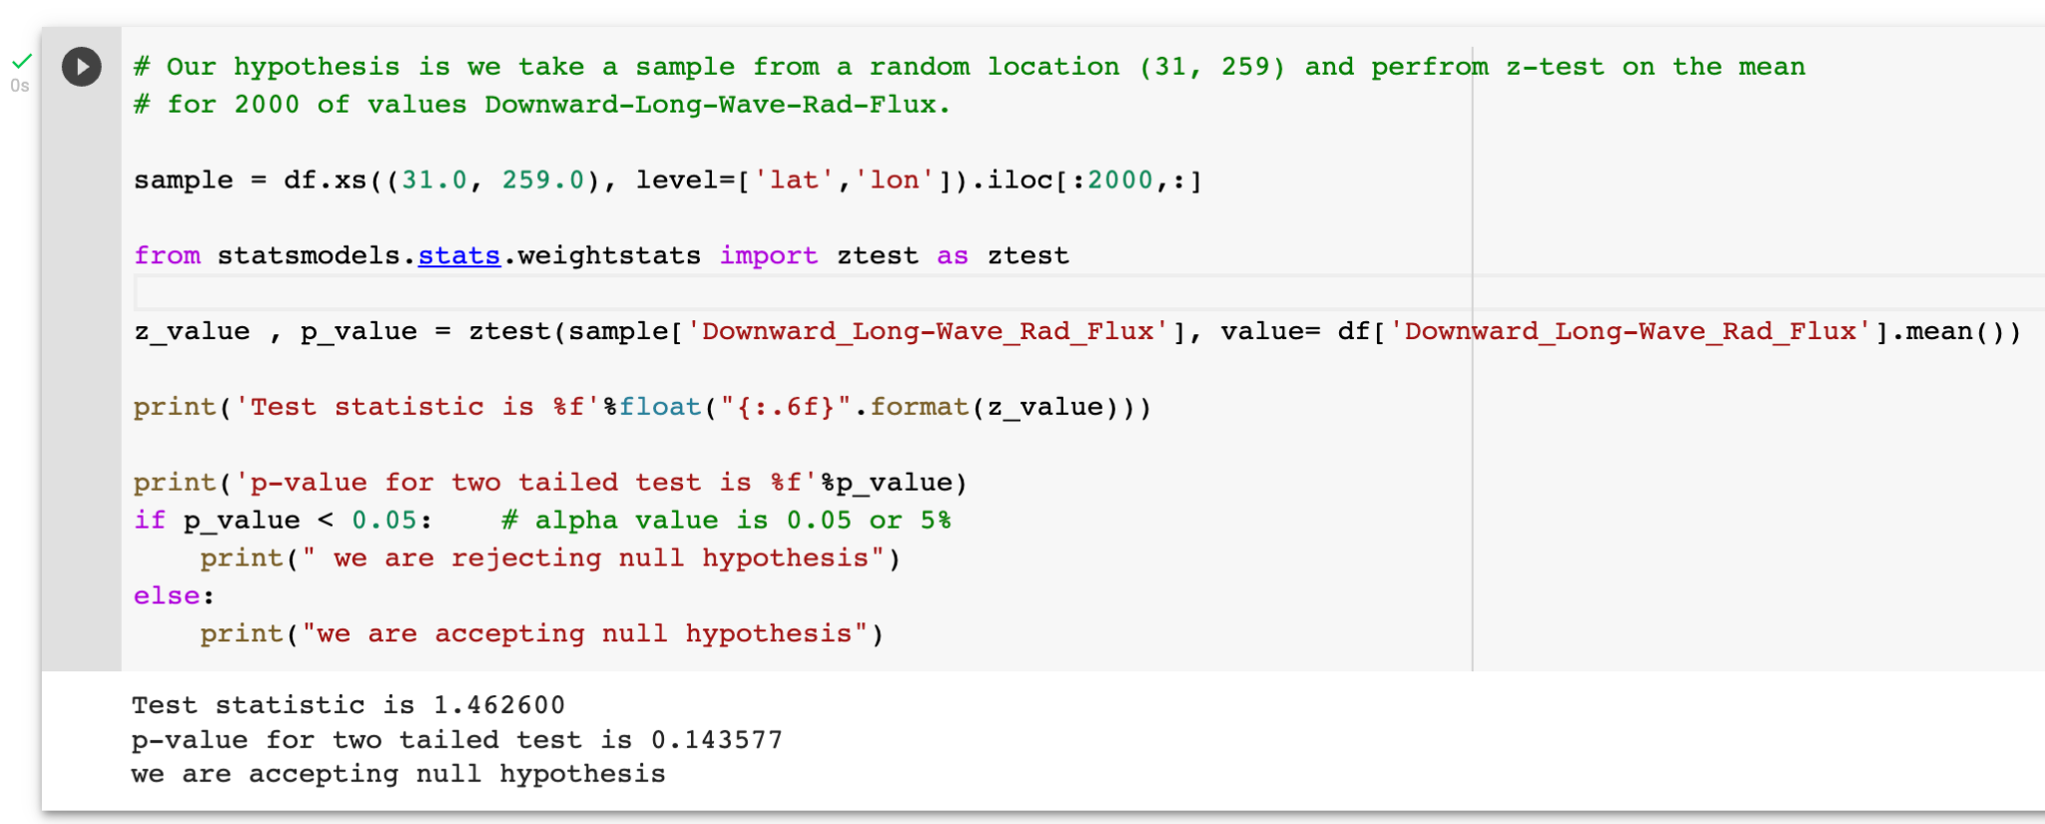
Testing our Hypothesis
Notes:
Box plots help visualize the distribution of quantitative values in a field. They are also valuable for comparisons across different categorical variables or identifying outliers, if either of those exist in a dataset. In this case, we have used a boxplot of the given features in order to observe their minimum value,median and the maximum value at a glance. For our data, the line graph of the entire dataset was unable to give such detailed information.

Slide 28
Thank You!
See ya in the Second Part!

